Slide 1
Biweekly Update
April 2, 2023
The Little Engineers that Could: Blake, Sam, Melanie, and Amy

Slide 2
WE HAVE A BARREL!

Slide 3
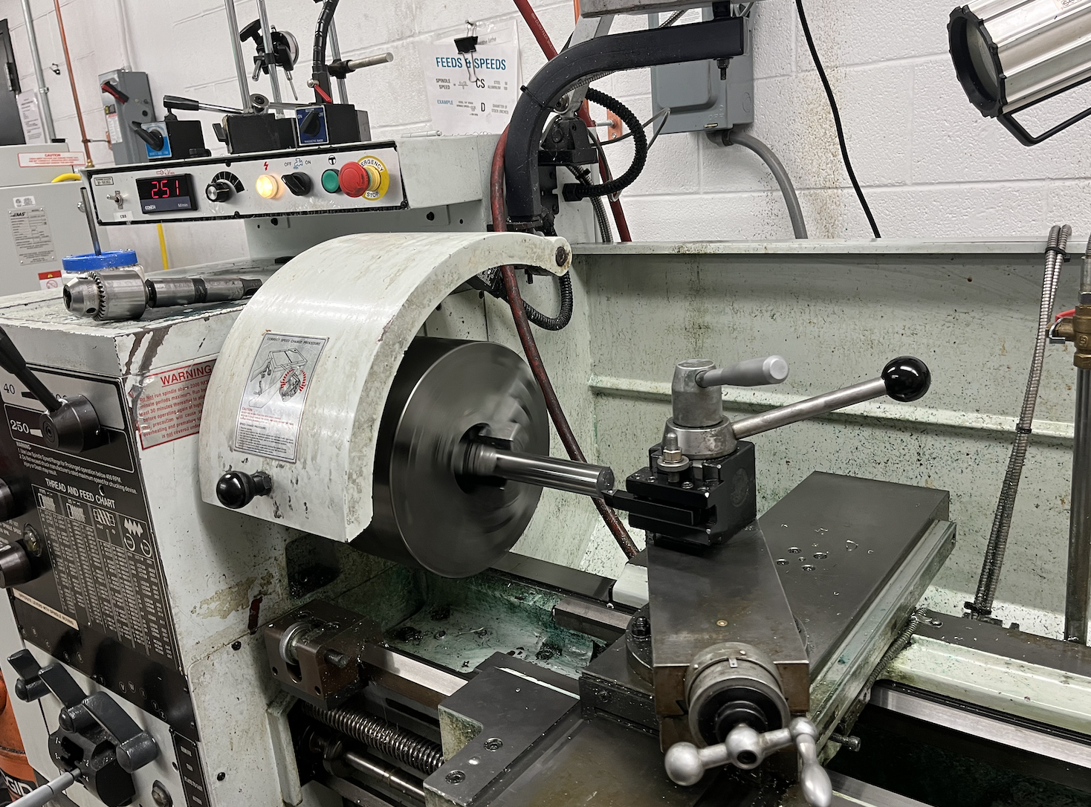
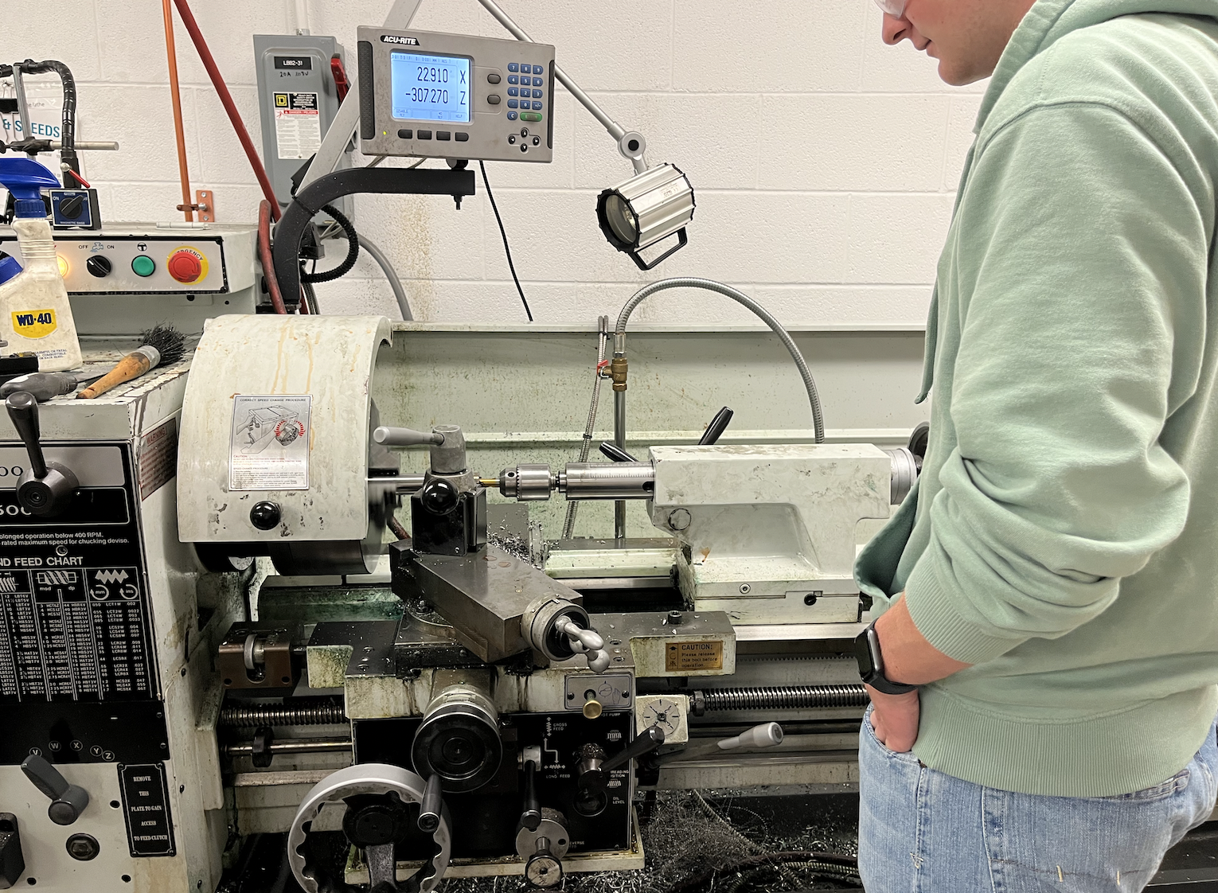
Machining the Barrel

Slide 4
Remaining Items Req’d for Assembly
The Housing: Sent to Borislav. Will be shipped in a week and a day once ordered
The Flange: Machined by David
3D printed items: Hopper, Fan Shrouds
Multiples of Items: It seems that Borislav may have ordered just one of certain items rather than the multiples that we required
We will begin assembly today

Slide 5
Final CAD changes
CADed fan shrouds
Added cut outs for VFD
Other minor changes
Had to adjust length of the housing

Slide 6
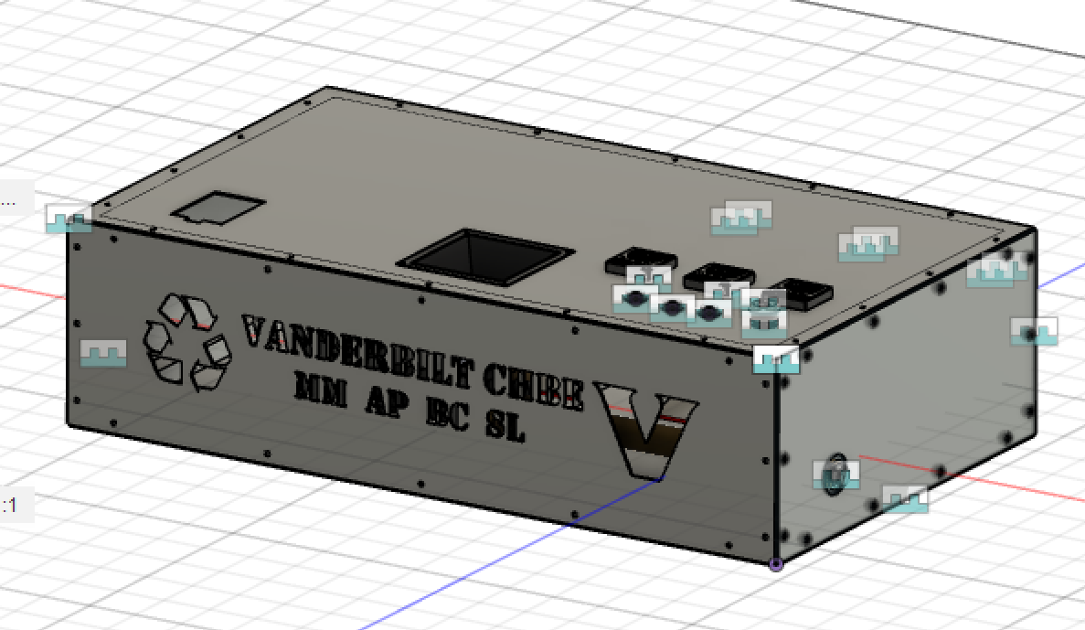
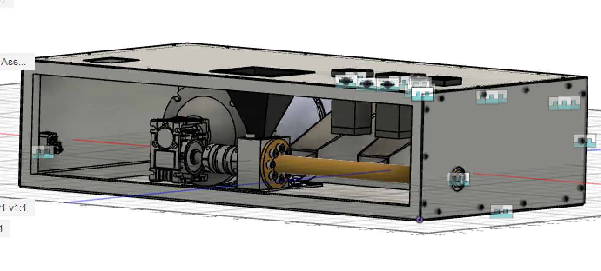
Completed CAD Model

Slide 7
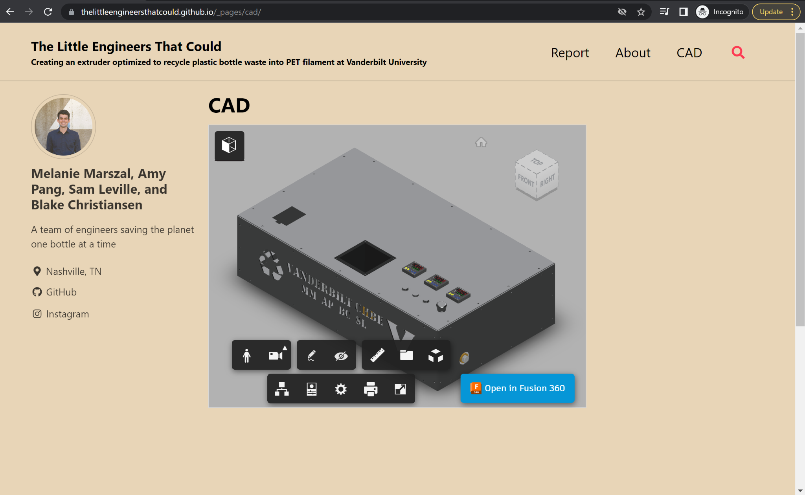
Website!

Slide 8
Action Items/Questions
Assemble Extruder
Video for Design Day: Spoken powerpoint?
Make more regrind → pelletize → make filament using our extruder
Work more on the report
Work on the github website
What format for our report?

Slide 9
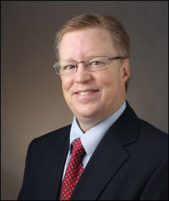
“You reap what you sow…”
Russell Dunn

